Slide 1
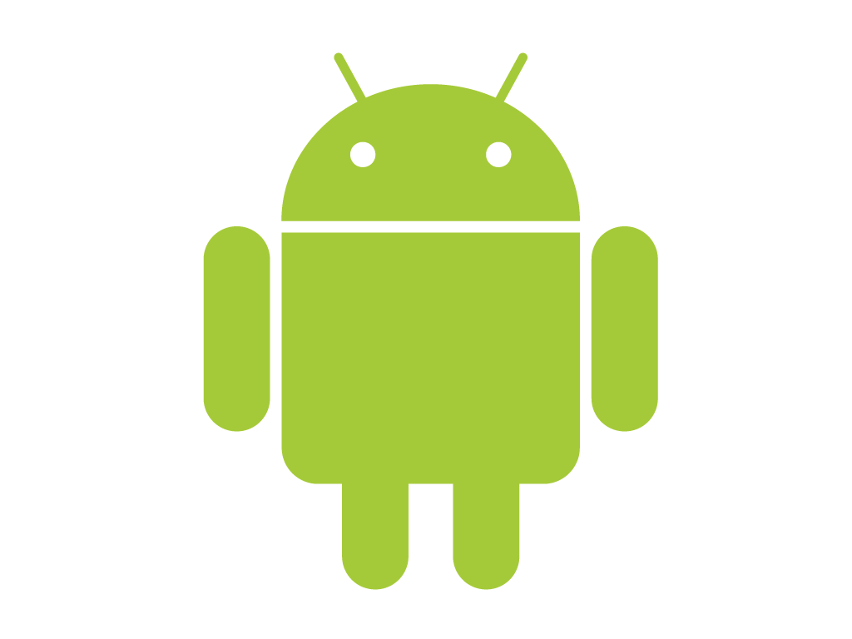
What is Android?
Android is a software stack for mobile devices that includes an operating system, middleware and key applications.
OR
A software platform and operating system for mobile devices
The Android SDK provides the tools and APIs necessary to begin developing applications on the Android platform using the Java programming language.

Slide 2
Features of Framework
Application framework enabling reuse and replacement of components
Dalvik virtual machine optimized for mobile devices
Integrated browser based on the open source WebKit engine
Optimized graphics powered by a custom 2D graphics library; 3D graphics based on the OpenGL ES 1.0(API) specification
SQLite for structured data storage

Slide 3
Continue…
Media support for common audio, video, and still image formats (MPEG4, H.264(or AVC (Advanced Video Coding) ), MP3, AAC, AMR, JPG, PNG, GIF)
GSM Telephony(Global System for Mobile ) (hardware dependent)
Bluetooth, EDGE, 3G, and WiFi (hardware dependent)
Camera, GPS & compass (hardware dependent)
Rich development environment including a device emulator, tools for debugging, memory and performance profiling, and a plugin for the Eclipse IDE

Slide 4
Code name & its version
List of Android version names:
Cupcake Version 1.5(API 3)
Donut Version 1.6(API 4)
Éclair Version 2.0,2.1(API 7)
Froyo Version 2.2(API 8)
Gingerbread Version 2.3.x(API 9,10)
Honeycomb Version 3.x.x (API 11-13)
Ice Cream Sandwich Version 4.0.x (API 14-15)
Jelly Bean Version 4.1.x (API 16)

Slide 5

Android Architecture

Slide 6
Applications
Android will ship with a set of core applications including
  an email client
  SMS program
  calendar
  maps
  browser
  contacts, and others.
  All applications are written using the Java programming language.

Slide 7
Application Framework
By providing an open development platform, Android offers developers the ability to build extremely rich and innovative applications.
Developers are free to take advantage of
  the device hardware
  access location information
  run background services
  set alarms
  add notifications to the status bar, and much, much more.

Slide 8
Developers have full access to the same framework APIs used by the core applications.
The application architecture is designed to simplify the reuse of components; any application can publish its capabilities and any other application may then make use of those capabilities
This same mechanism allows components to be replaced by the user.

Slide 9
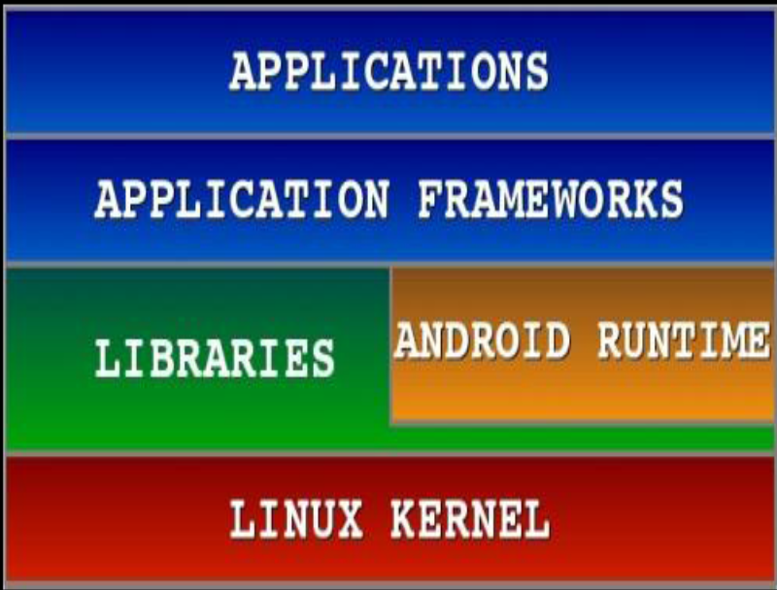
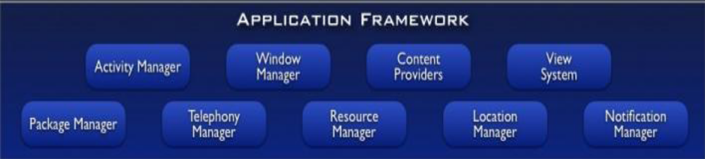
Android S/W Stack –App Framework
Most of the application framework accesses these core libraries through the DalvikVM

Slide 10
A rich and extensible set of Views that can be used to build an application, including lists, grids, text boxes, buttons, and even an embeddable web browser
Content Providers that enable applications to access data from other applications (such as Contacts), or to share their own data
A Resource Manager, providing access to non-code resources such as localized strings, graphics, and layout files
A Notification Manager that enables all applications to display custom alerts in the status bar
An Activity Manager that manages the lifecycle of applications & provides a common navigation backstack

Slide 11
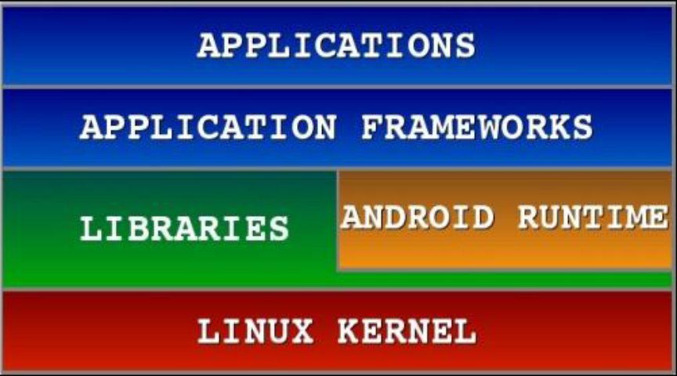
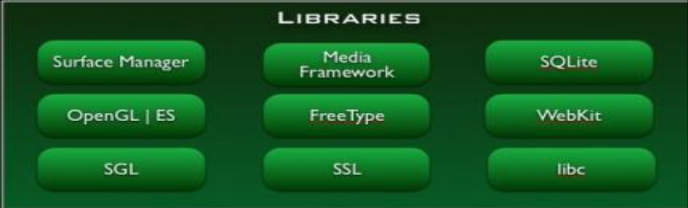
Android S/W Stack -Libraries
Including a set of C/C++ libraries used by components of the Android system
Exposed to developers through the Android application framework

Slide 12
Libraries
System C library - a BSD(Berkeley Software Distribution)-derived implementation of the standard C system library (libc), tuned for embedded Linux-based devices
Media Libraries - the libraries support playback and recording of many popular audio and video formats, as well as static image files, including MPEG4, H.264, MP3, AAC, AMR, JPG, and PNG
Surface Manager - manages access to the display subsystem and seamlessly composites 2D and 3D graphic layers from multiple applications
LibWebCore - a modern web browser engine which powers both the Android browser and an embeddable web view

Slide 13
SGL(Scalable Graphics Library ) - the underlying 2D graphics engine
3D libraries - an implementation based on OpenGL ES 1.0 APIs;
FreeType - bitmap and vector font rendering
SQLite - a powerful and lightweight relational database engine available to all applications

Slide 14
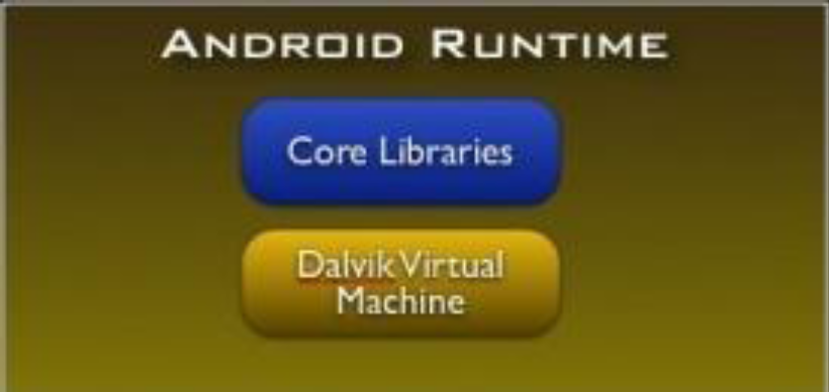
Android S/W Stack -Runtime
Core Libraries:
Providing most of the functionality available in the core libraries of the Java language

Slide 15
DVM
Every Android application runs in its own process, with its own instance of the Dalvik virtual machine.
Dalvik has been written so that a device can run multiple VMs efficiently.
The Dalvik VM executes files in the Dalvik Executable (.dex) format which is optimized for minimal memory footprint. OR a format that is optimized for efficient storage and memory-mappable execution.
The VM is register-based, and runs classes compiled by a Java language compiler that have been transformed into the .dex format by the included "dx" tool.
The Dalvik VM relies on the Linux kernel for underlying functionality such as threading and low-level memory management

Slide 16
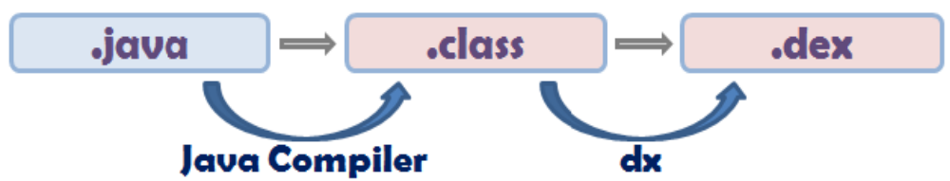
Continue …
Dx
Converts Java .class bytecode into Android .dex bytecode.

Slide 17

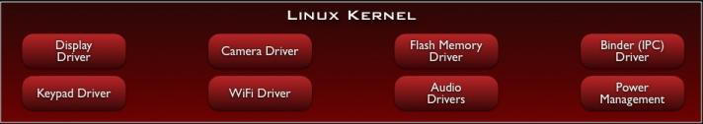
Android S/W Stack –Linux Kernel
Relying on Linux Kernel 2.6 for core system services

Slide 18
Linux Kernel
Android relies on Linux version 2.6 for core system services such as
  Security
  memory management
  process management
  network stack
  and driver model.
  The kernel also acts as an abstraction layer between the hardware and the rest of the software stack.

